Slide 1


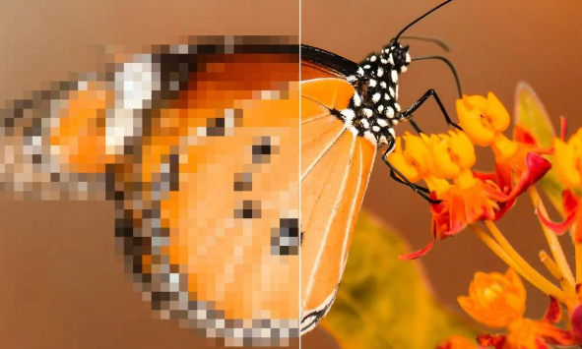
DETECT PIXELATED IMAGES AND CORRECT IT

Slide 2
PROBLEM STATEMENT
The task involves both image classification (detecting pixelation) and image generation (restoring pixelated images).
The detection algorithm must run at 60 FPS, while the restoration algorithm should achieve 20 FPS.
Both algorithms should be highly accurate, with detection having a focus on minimizing false positives
Algorithms should work seamlessly with 1080p images, potentially downscaling for processing.
Evaluation based on F1-score, precision-recall for detection, and LPIPS, PSNR for restoration

Slide 3


UNIQUE IDEA BRIEF (SOLUTION)
Detection model
MobileNet is a deep learning model designed specifically for efficient image classification and other vision tasks on mobile and embedded devices.
This model uses depthwise seperable convolution approach which reduces the number of parameters and computational cost with higher accuracy
MobileNet is designed to have a small model size, which is crucial for deployment on devices with limited storage and memory and comes with pre trained weights on large datasets like imagenet
Lower memory consumption
High resolution
Pixelated

Slide 4
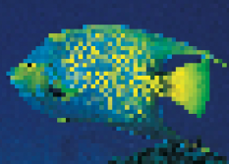
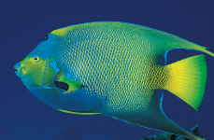
UNIQUE IDEA BRIEF (SOLUTION)
Correction model
The use of SRCNN(Super-Resolution Convolutional Neural Network) model is a deep learning-based approach for image super-resolution. It consists of a series of convolutional layers designed to learn the mapping between low-resolution (pixelated) and high-resolution images.
The use of a deeper network architecture with varying filter sizes for different layers.
A learning rate scheduler to improve model training efficiency.
Handling and preprocessing of RGB images to ensure uniform input for the model.
pixelated
corrected

Slide 5

FEATURES OFFERED
Detection model
Utilizes depthwise seperable convolutions to reduce the computational cost and number of parameters compared to traditional CNN’s.
Width and resolution multiplier helps in decreasing the computational complexity and allowing for a balance between speed and accuracy
Small model size making it suitable for real time applications
Due to its lightweight and efficient nature, MobileNet can be deployed on mobile phones, tablets and embedded devices, extending its use beyond powerful desktop environments and can be converted and used with other frameworks such as PyTorch, enabling flexibility in model deployment..

Slide 6
FEATURES OFFERED
Correction model
Allowing flexibility in input dimensions
Adam optimizer, known for its efficient handling of sparse gradients _and adaptive learning rate, which speeds up training and ensures _better convergence.
Consists of multiple convolutional layers with varying filter sizes to capture different levels of image features
The trained model is saved in HDF5 format, allowing for easy loading and deployment in future applications.

Slide 7
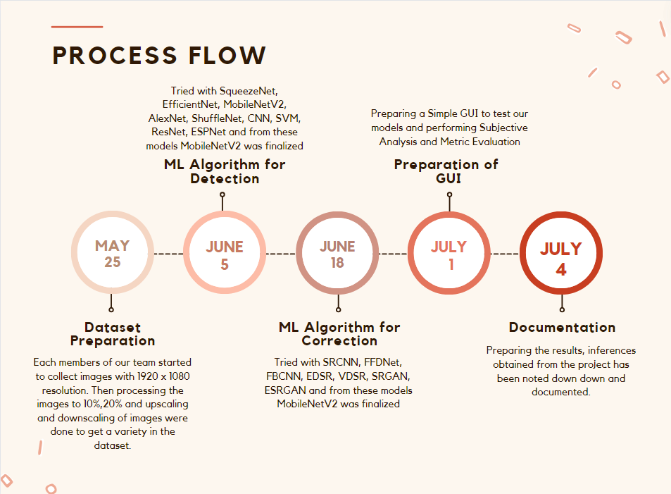


Slide 8

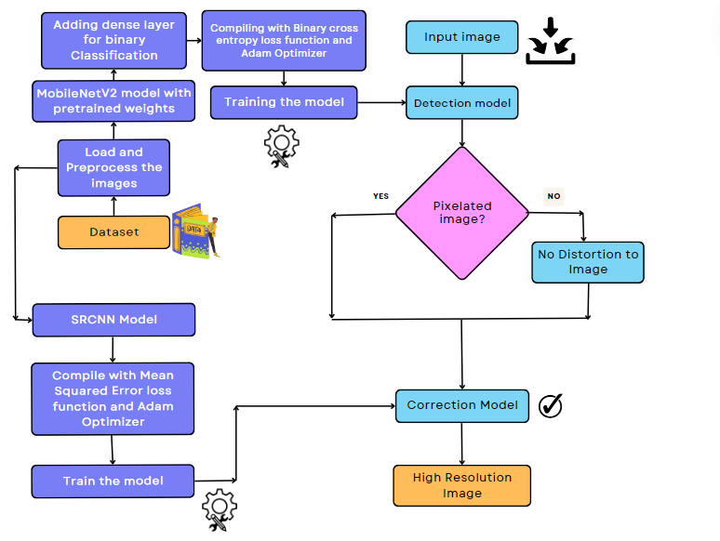
ARCHITECHTURE DIAGRAM

Slide 9
SOURCE CODE LINKS
https://github.com/jenojeba/Detection-and-Correction-of-Pixelated-Images
Datasets:
https://www.kaggle.com/datasets/aleenasaj/image-pro
https://www.kaggle.com/datasets/aleenasaj/pix-og

Slide 10

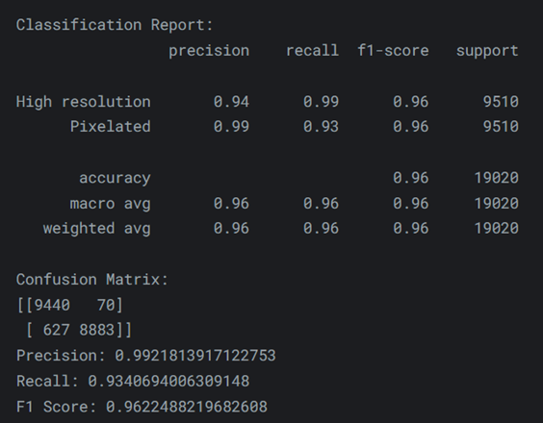
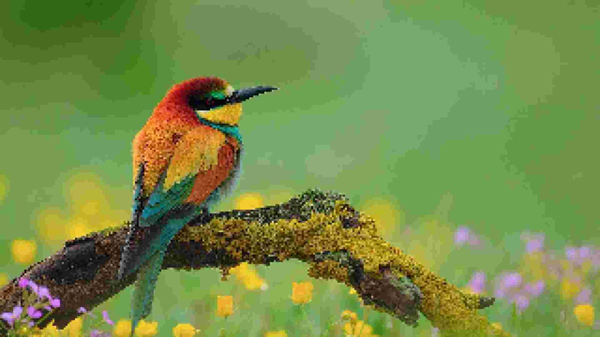


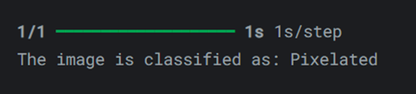
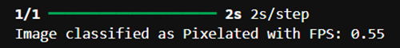
Output with metric evaluation
Detection model

Slide 11

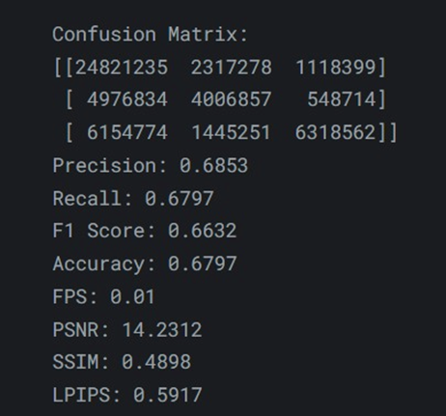
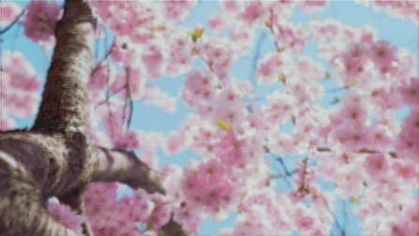
Output with metric evaluation -Correction model
Pixelated Image
Corrected Image

Slide 12
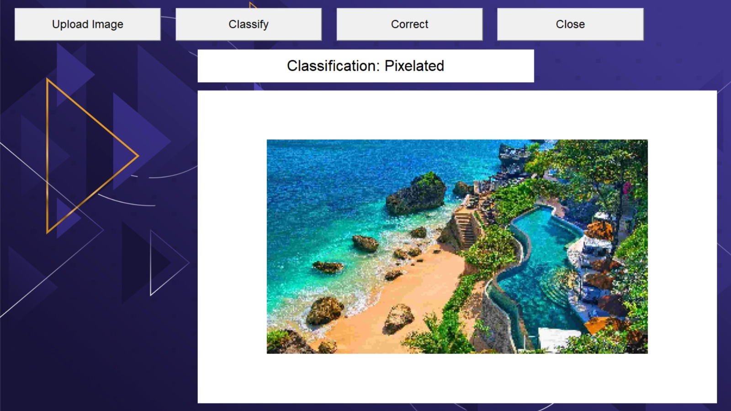
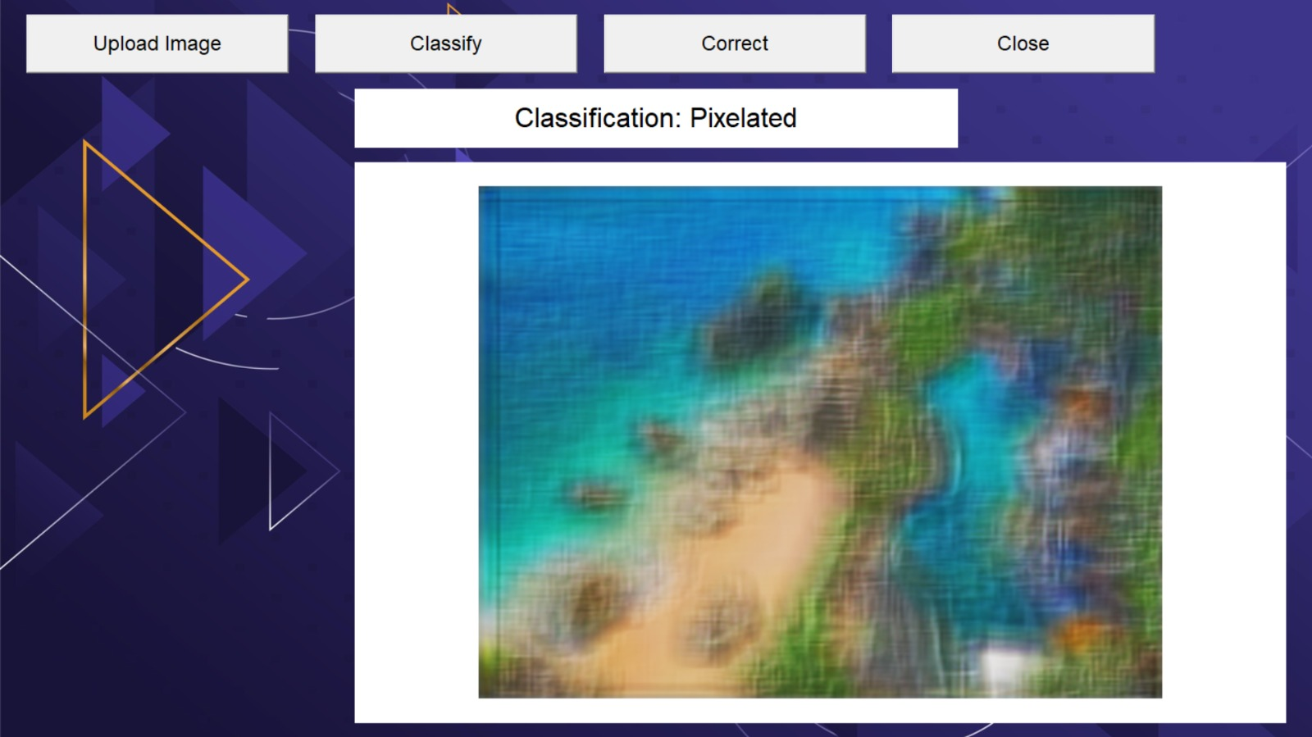
GRAPHICAL USER INTERFACE
Detection
Correction

Slide 13

Technologies used
The Models uses:
Python as it core programming language.
TensorFlow and Keras as frameworks for building and training deep learning models
NumPy for numerical operations and handling arrays.
Pillow (PIL) for image manipulation
Scikit-Learn for data splitting and evaluation.
OS and Shutil for file and directory operations.
CNNs (Convolutional Neural Networks) for processing and enhancing images.
The use of Kaggle Notebooks provide an integrated environment for data science and machine learning, offering several features that facilitate the development, testing, and sharing of machine learning models.

Slide 14
Subjective Analysis
The Correction model has a mean opinion score of 3.9/5
(100 images were obtained from the model and the images were rated out of 5)
The Detection model has a mean opinion score of 4.39/5
(100 images were obtained from the model and the images were rated out of 5)

Slide 15
Team members and contribution
J Jenolin Jeba (Leader) : Collected and curated dataset images, developed multiple machine learning models utilizing various algorithms like SqueezeNet, EfficientNet, MobileNet, AlexNet , ShuffleNet, ResNet, ESPNet, SRCNN, FFDNet, SRGAN, ESRGAN etc., and independently completed the final ML model notebook, and conducted metric evaluation. The work of documentation was also finished.
Aleena Saji : Contributed a significant portion of the dataset, developed a GUI model for the project, debugged errors in multiple models, prepared ML model with RNN,SVM,SRCNN and assisted with the subjective analysis and documentation.

Slide 16
Team members and contribution
Jenolin Esther S : Contributed to dataset creation , tried making ML model and conducted the subjective analysis.
Prajusha R :Contributed to dataset creation , tried making ML model and conducted the subjective analysis.
Bettina Ninan : Contributed to dataset creation , tried making ML model.

Slide 17
CONCLUSION
The model demonstrates a strong capability to classify pixelated and high-resolution images effectively.
The SRCNN model serves as a foundational approach to super-resolution, demonstrating the feasibility of correcting pixelated images.
By building upon this foundation with further refinements and advanced techniques, the model's capabilities can be significantly enhanced for various high-resolution image reconstruction tasks

Slide 18
REFERENCES
https://wallpaperaccess.com
https://unsplash.com/
https://pexels.com/

